Slide 1
HoMePIT- Final Presentation
By Erik Anderson, Jerome Chestnut, and Maxwell Fugette

Slide 2
Introduction
HoMePIT will assist with planning a household’s menu and tracking its supply, usage, and replacement of ingredients and other foodstuffs.
Its primary features are the Pantry, Recipe Book, Meal Planner, and Shopping List
This presentation will serve to summarize the current state of the project, its structure, design, and known issues.

Slide 3
Tools and Tech
Platform: Firefox, Chrome, Safari
OS: Windows 10 & 11, Android
IDE: VSCode - abandoned Replit & VisualStudio
Languages: JS, TS, HTML, CSS, PL/pgSQL - Abandoned C#
3rd party tools, libraries, & services: GitHub, SupaBase, React, Bootstrap, MaterialUI, FullCalendar
Abandoned ASP.NET
Server software & services: Node.JS, Google Firebase, SupaBase

Slide 4
Database Design
Designed with 3NF in mind - no functional dependencies only on the primary key
Some data duplication exists as artifacts from earlier development assumptions
Has been left for compatibility
No null entries
Exception: Ingredients Audit table
Resolves null-value issues

Slide 5
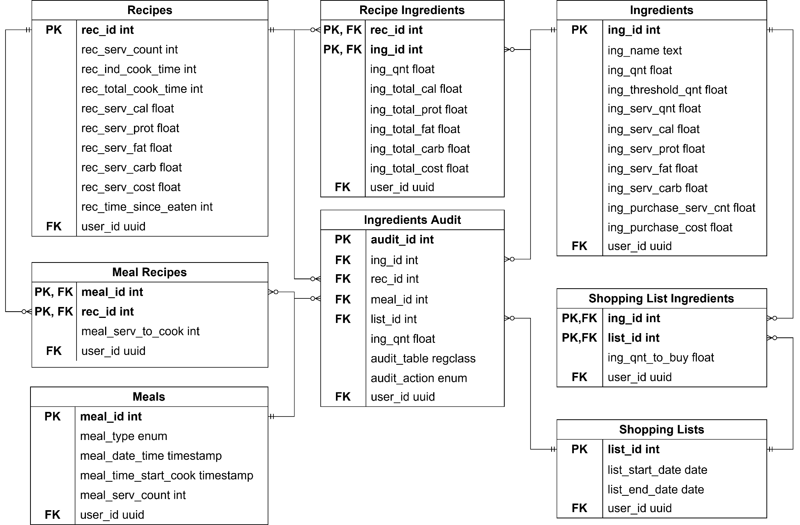

Slide 6
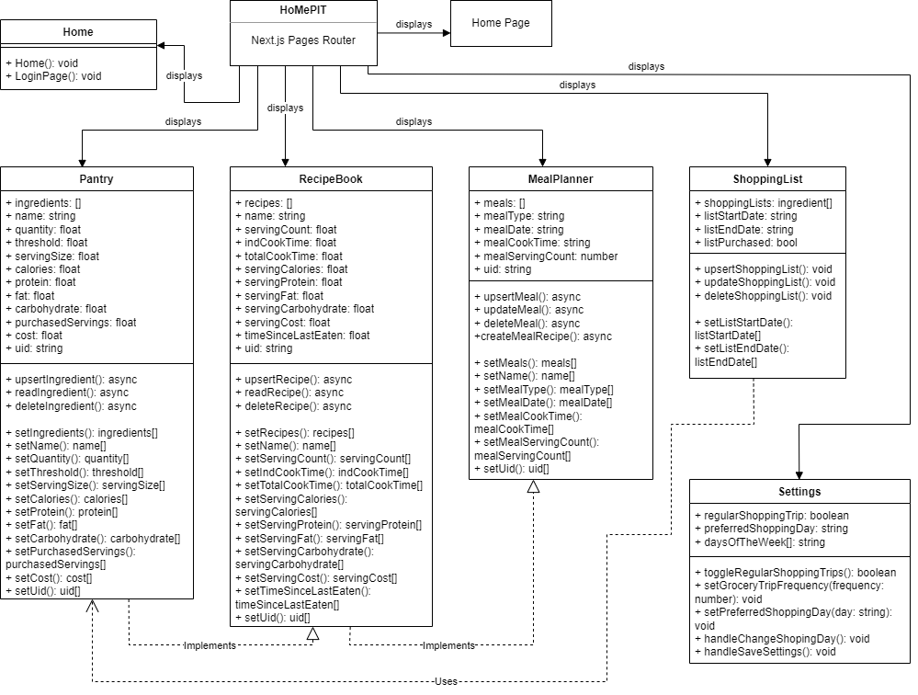

Slide 7
Frontend Design
Upon opening HoMePIT, the user will be presented with a Sign In prompt where they will be able to login with their google account.
The top “App Bar” displays a menu icon, HoMePIT’s logo, and a settings icon.
Upon clicking the menu icon, the side navigation bar will appear.
Clicking the logo will take the user back to the Home page.
The sidebar is how the user will navigate throughout HoMePIT, with tabs for Home, Pantry, Recipe Book, Meal Planner, Shopping List, and Settings.

Slide 8
Page Structure
The Pantry Recipe Book, and Shopping list are structured very similarly, with each consisting of the following components:
A table displaying data from the given database table.
An “Add” button above the table to add to the database.
Options on each row to edit or delete the entry (or in the case of Shopping List, only delete).
A modal for adding and editing data that appears when the respective button is clicked.
The Meal Planner consists of an “Add Meal” button, which when clicked opens a modal in the same manner as above for adding meals.
These meals appear in a column directly below this button.
Directly to the left of this column is the Calendar component.

Slide 9
Code Structure
All major pages have the same basic structure from top to bottom, those being:
Import statements and function declarations
State variables
Core logic
Return statement for visual display
An upsert function is used for the creation and editing of data objects.
All visual elements are defined in a functions return() statement, which is characteristic of Next.js projects.

Slide 10
Third Party Libraries
Being a Next.js project, React libraries are heavily used throughout HoMePIT.
React state variables made storing data relatively easy.
Supabase’s auth-helpers-react library was used to create the Supabase Client for the project.
In place of native HTML, Material UI was opted for in most instances.
This had the effect of making a nicer-looking user interface that suited our needs more
Google Firebase was used to host the site, initially through the free Spark plan, however as HoMePIT grew an upgrade to the Blaze plan was necessary.

Slide 11
Known Bugs
Database
Invalid shopping list insertions and updates return null instead of an error
Frontend
Ingredient nutrition displays improperly
Dragging meals to the calendar crashes
Duplicate meals can be generated
Ingredient and recipe editing doesn’t populate with existing information
UI does not adapt sufficiently to screen resolution

Slide 12
Future Work
4 months of future work
Twice as much as was available
Increased familiarity with HoMePIT

Slide 13
Future Work
More shopping list insertions allowed
Allow shopping list date range updates
Additional shopping list ingredients updates
Purchase location functionality & optimization
Leftover functionality
Expiring ingredient functionality
Greater past data input functionality
Purchase location, leftovers, & ingredient expiry UI
Shopping list confirmation UI
Real time database subscription
Improved general UI & UX
Table sorting & search UI & UX
Tagging UI & UX
UI & UX for non-g/mL units
Better Android compatibility
Settings page functionality, UI, and UX

